Slide 1
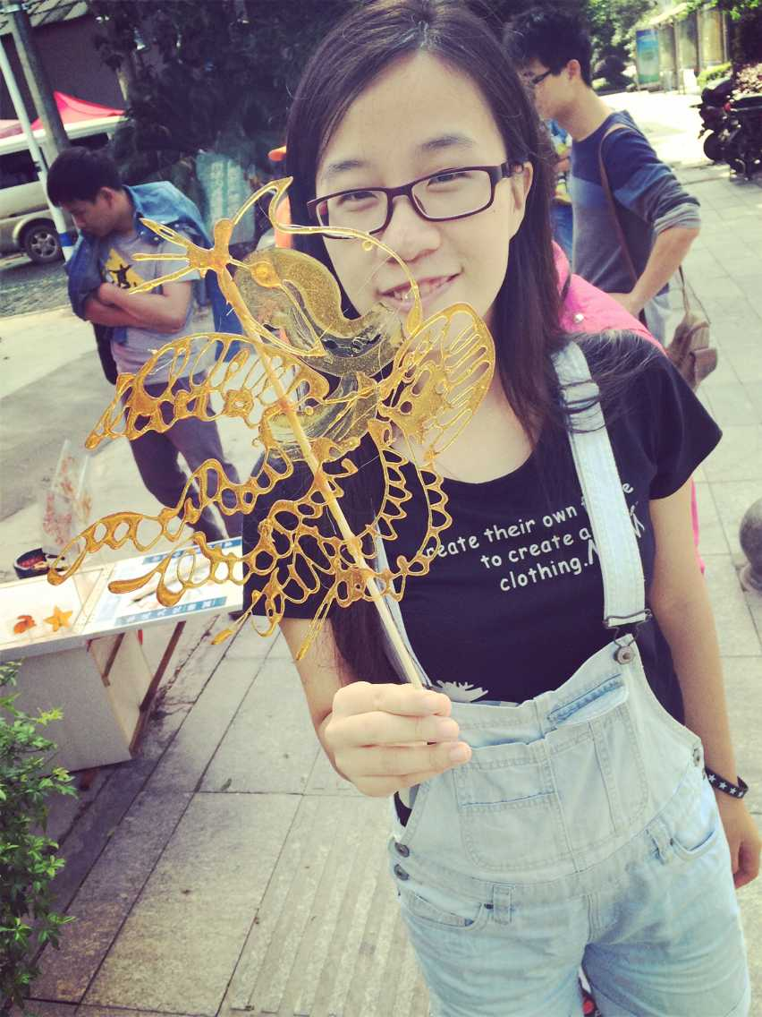

Liu Xiaoyu
Nanyang Technological University
Information Engineering & Media
June 2018
Digital Engineering, Vault
Tarun Gupta & Yogeshwar Gandhe
Intern Software Automation Operations

Slide 2

Experience real working environment
Build relationship with colleagues, teamwork
Problem-solving skills, programming skills (C#)
Quality Assurance
Automated API Test Cases
Smoke Tests For New Builds
Coded UI Tests
Other Tests…
http://www.autodesk.com/products/vault-family/overview

Slide 3
Read Through Previous Tests
Ask
Try Simple Tests
Ask
Make Modifications
Determine Requirements
Ask
Manually try in Vault
Write test cases
Ask
Code Review
Ask
Make Modifications
Submit
Do Smoke Tests
Ask
Update Wiki
Construct Report

Slide 4
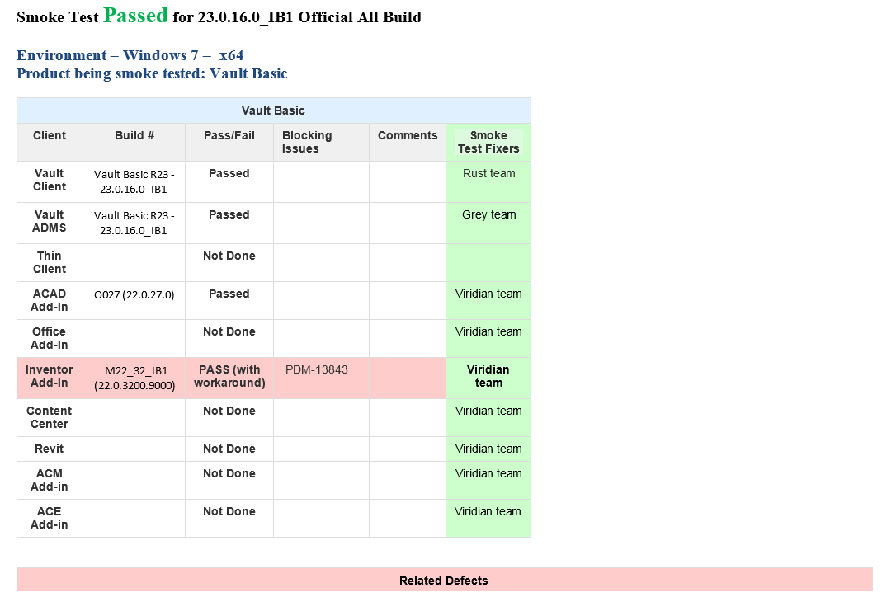
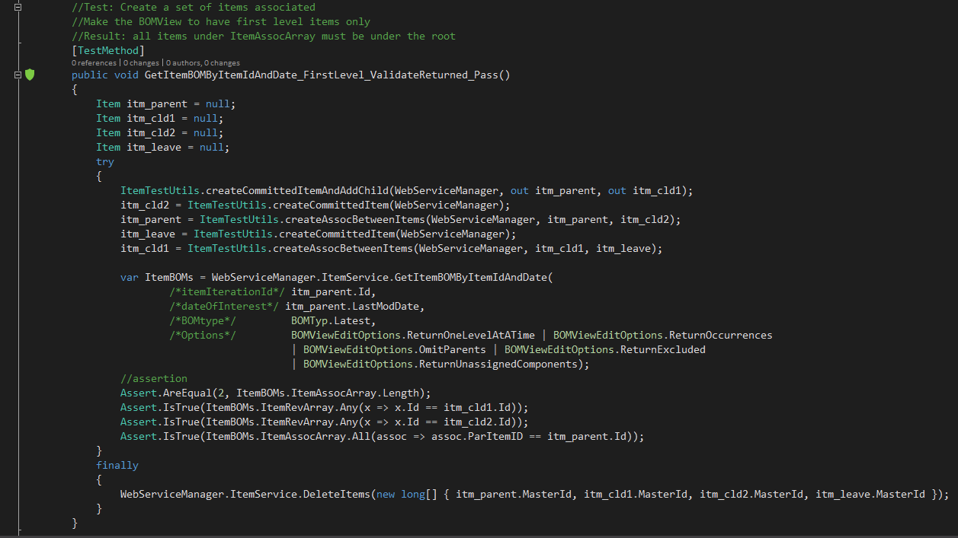
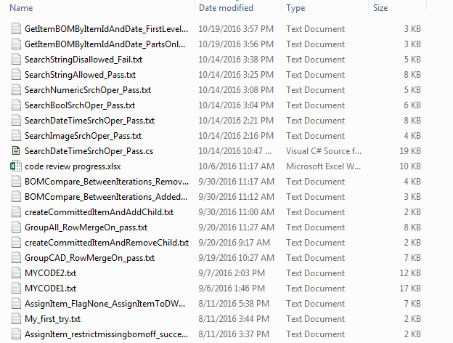
What I have done:
What I have gained:
Great Work Experience
Interpersonal & Teamwork Skill
Use ACAD/Inventor/Vault
C# Programming Skill
Other Software Engineering Knowledge
Better Resume
A LOT of help
Friends

Slide 5
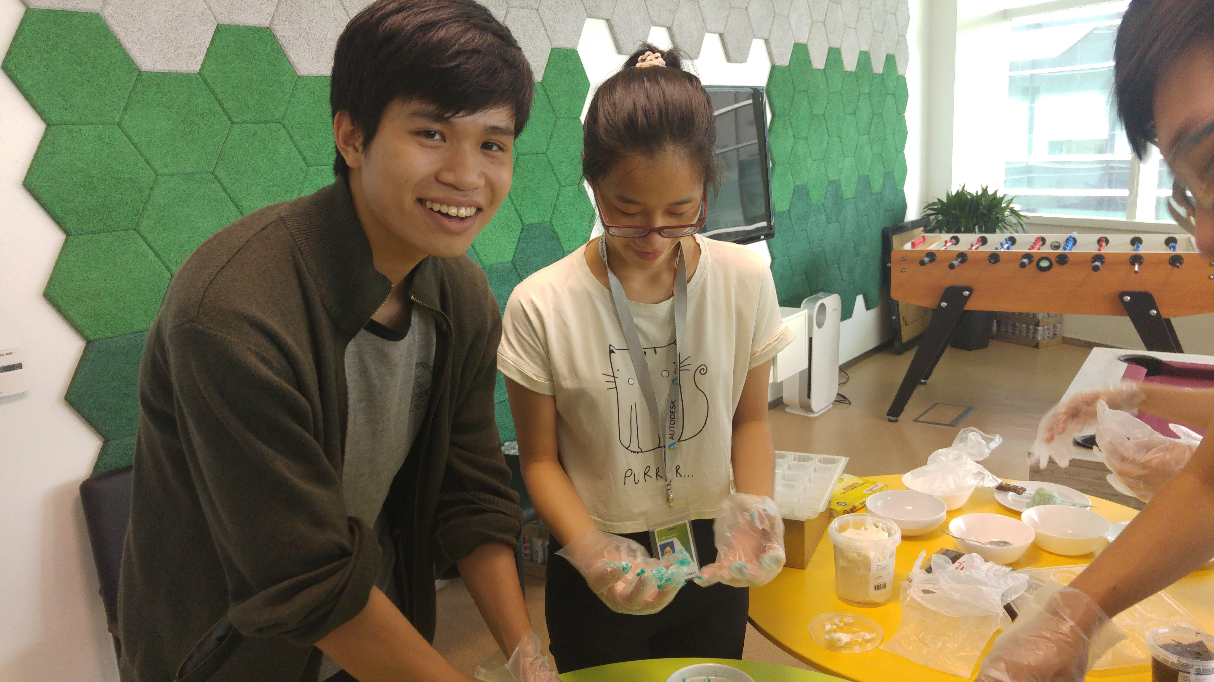
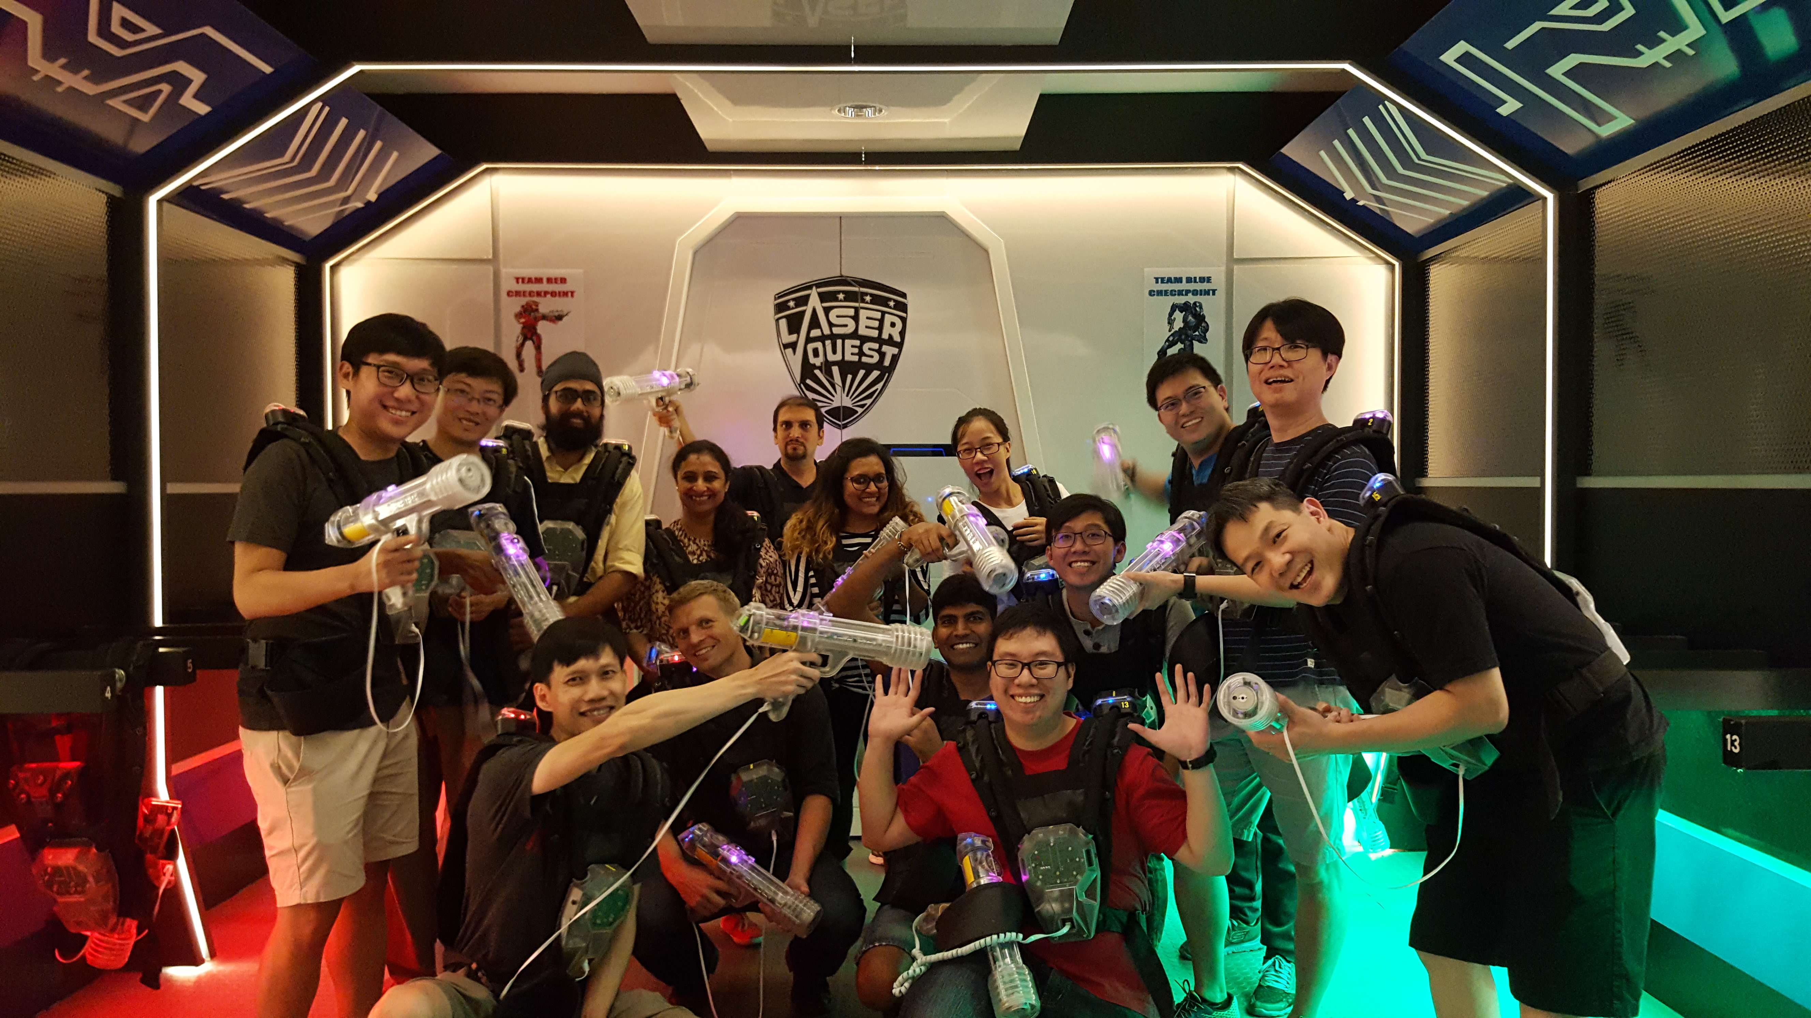
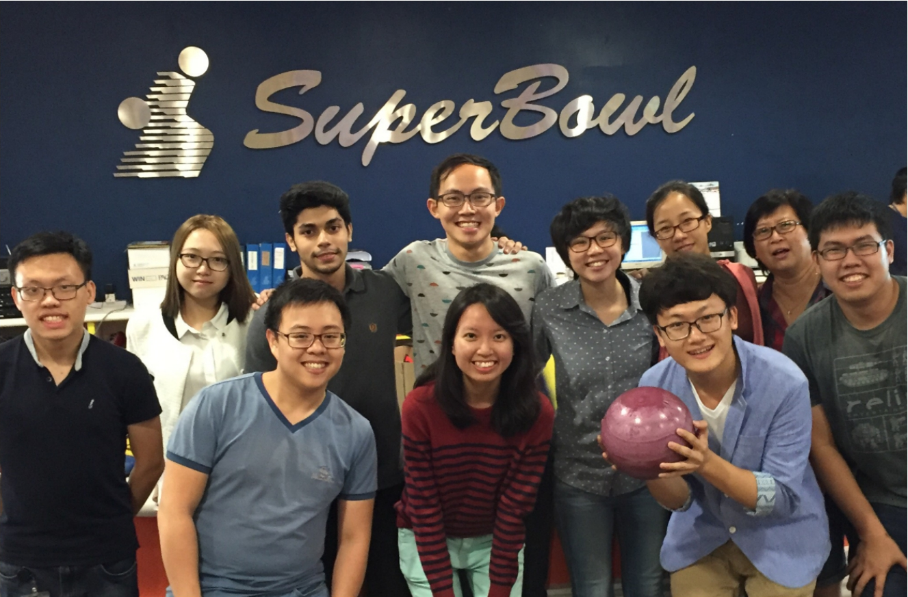
@ giphy.com
@ ASRD PDG PLM FUN CLUB
@ Kashyap Joshi
@ Autodesk Careers Facebook

Slide 6
@giphy.com

